Slide 1
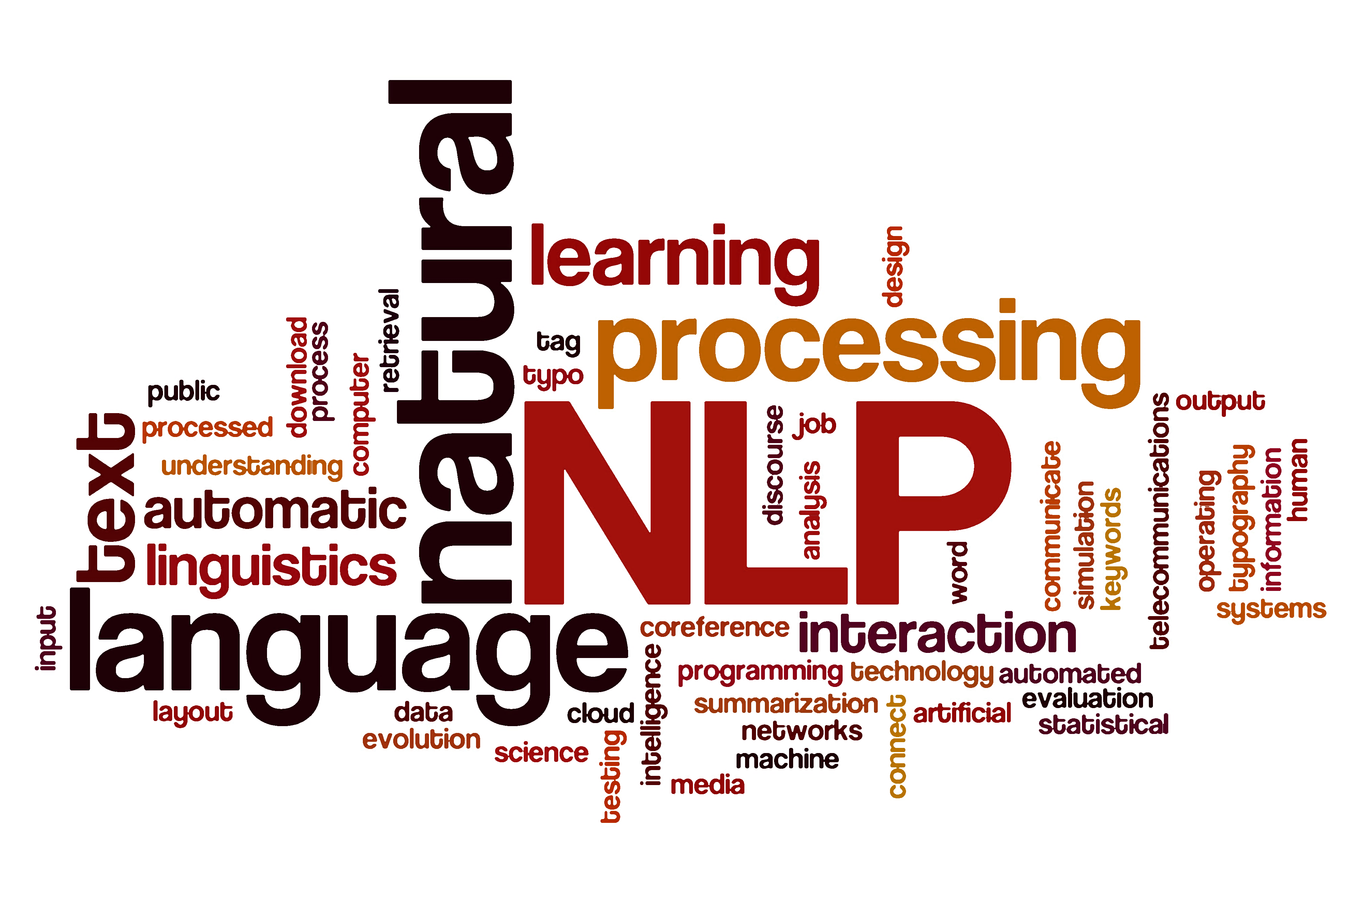

Prediction of Stock Market Using NLP (Natural Language Processing)
Kyuhwan Kim 500292801
CKME 136 Final Project
August 2020

Slide 2
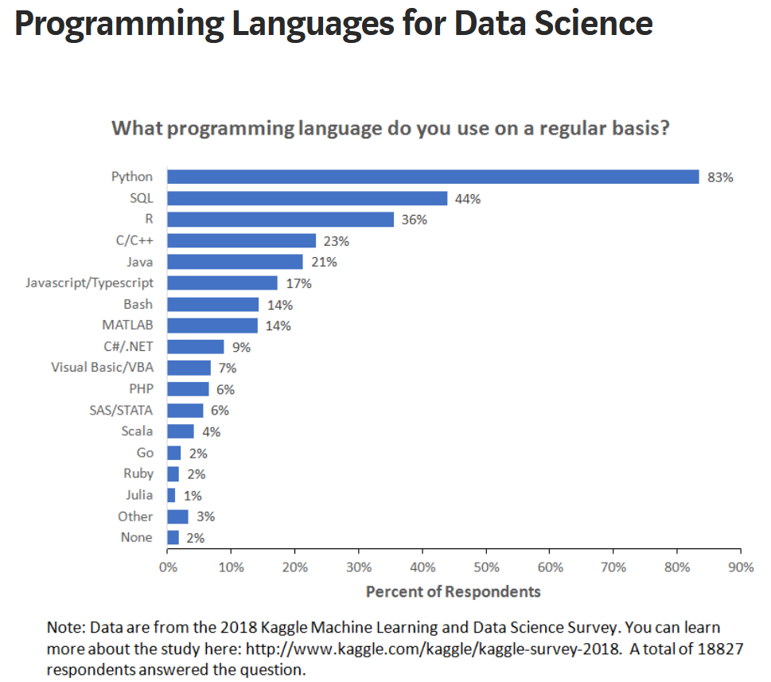
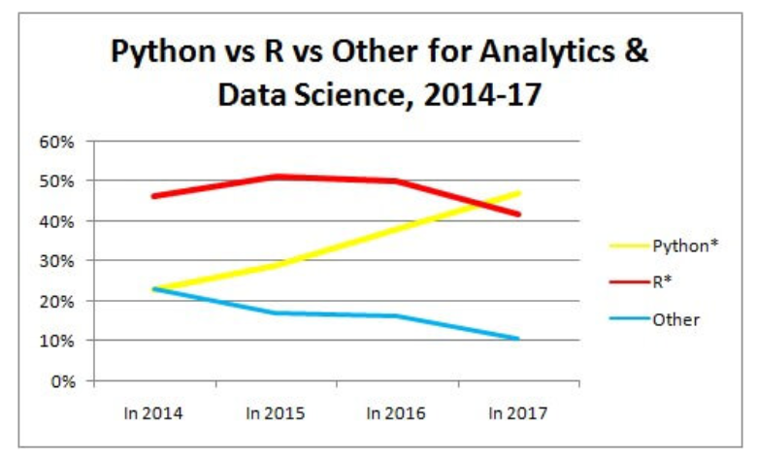
https://www.techleer.com/articles/315-python-overtakes-r-as-the-most-preferred-analytics-machine-learning-language/

Slide 3


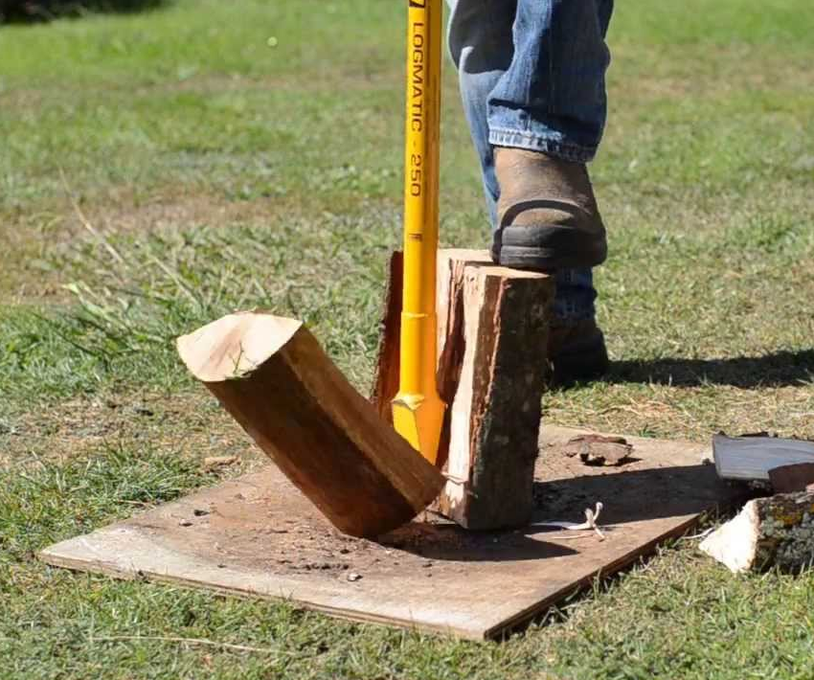






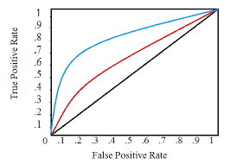
Steps taken towards the objective
Explore the Data
‘Clean’ and Prepare the Data
Split the Data
Build the Model
Present the Findings
Validate the Model
Test the Model
Train the Model

Slide 4
















Tools Used for Data Analytics

Slide 5

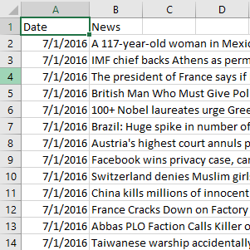
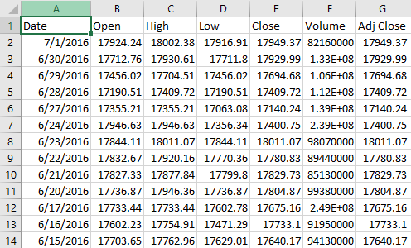
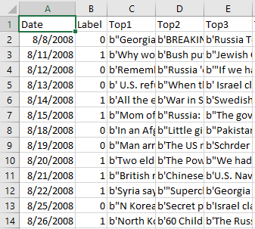
About the Dataset
Sun, J. (2016, August). Daily News for Stock Market Prediction, Version 1. Retrieved [June 04, 2020] from https://www.kaggle.com/aaron7sun/stocknews.
RedditNews.csv
DJIA_table.csv
Combined_News_DJIA.csv
Challenge Accepted!

Slide 6
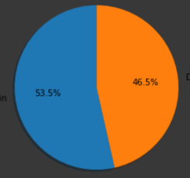
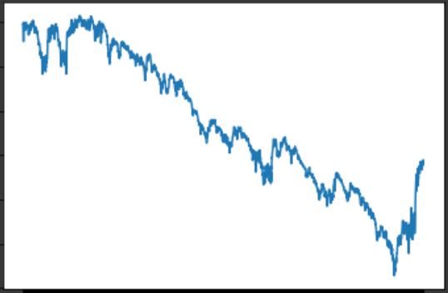
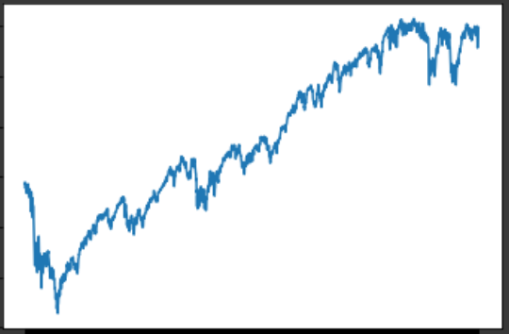
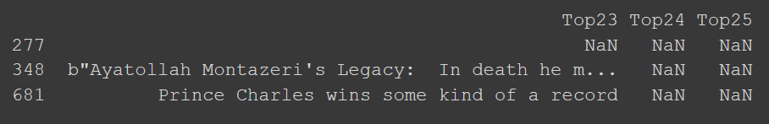
Problems with the data
I do not know how to code like an expert
and I do not know how to do
machine learning
Initially thought this was the data.
But was supposed to be this!
Each string was encased with b” <text> “ or b’ <text> ‘
How do I combine the data to prepare for machine learning?
Even after the data has been ‘cleaned’ there were still missing data to deal with
Date | News
Date | Top 25 Reddit News Articles

Slide 7
NLP and Text Preprocessing
Text Preprocessing
What is NLP?
Lowercase/Uppercase
Stop Words
Removing Punctuation
Stemming/Lemmatization
Removing Punctuations
BoW and TF-IDF

Slide 8
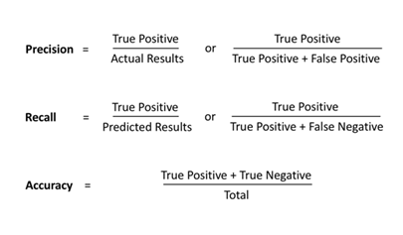
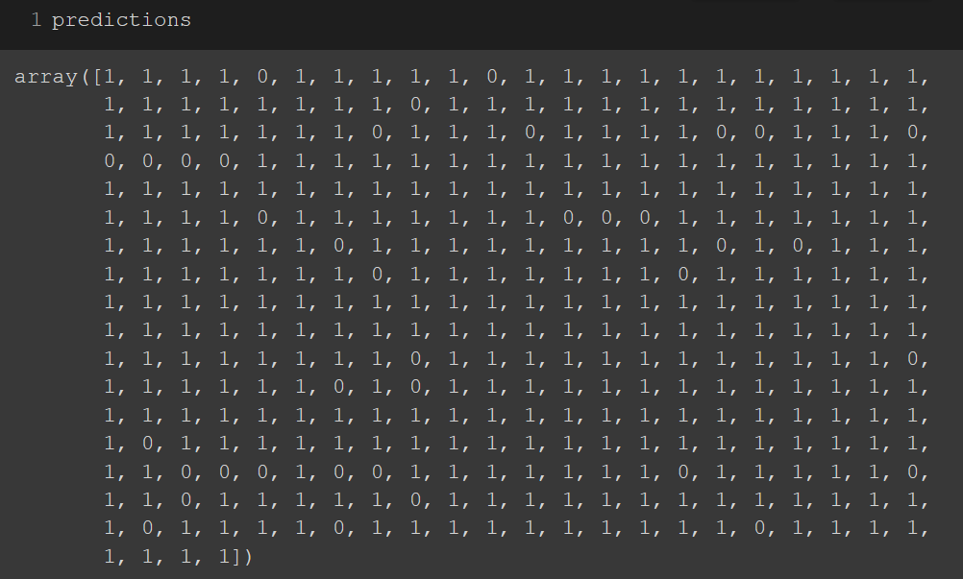
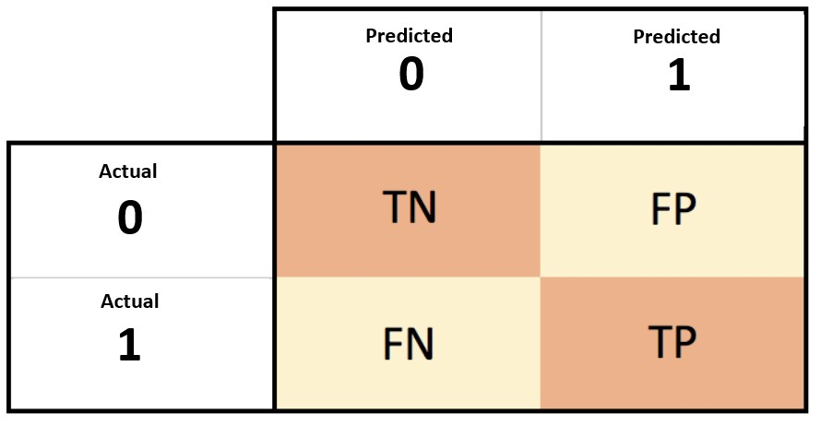
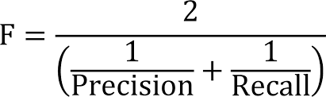
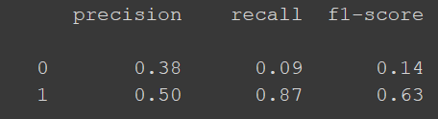
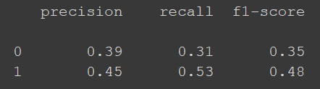
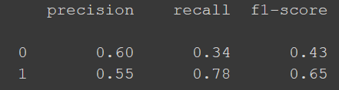
Confusion Matrix and its measurements
(Sum of predicted ‘positives’)
(Sensitivity)
(Sum of actual ‘positives’)
Test 1
Test 2
Test 3
 | Predicted
Actual | 0 | 1
0 | 16 | 169
1 | 26 | 167
Accuracy = 48.4%
 | Predicted
Actual | 0 | 1
0 | 58 | 127
1 | 91 | 102
Accuracy = 42.3%
 | Predicted
Actual | 0 | 1
0 | 62 | 123
1 | 42 | 151
Accuracy = 56.3%

Slide 9
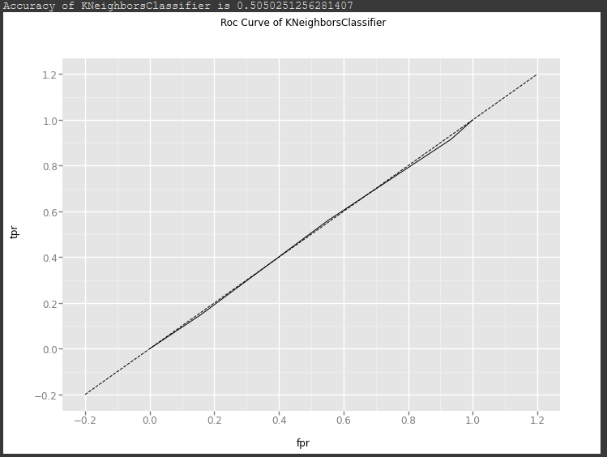
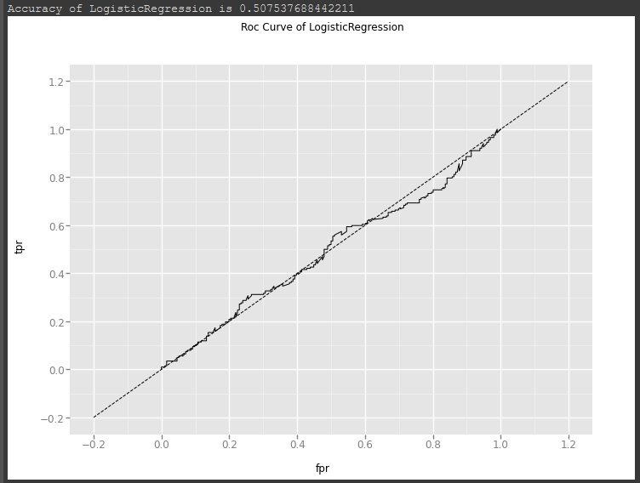
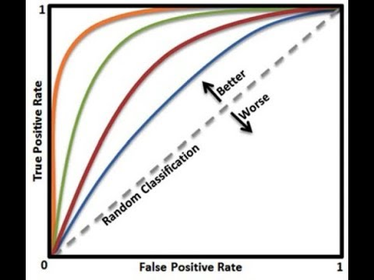
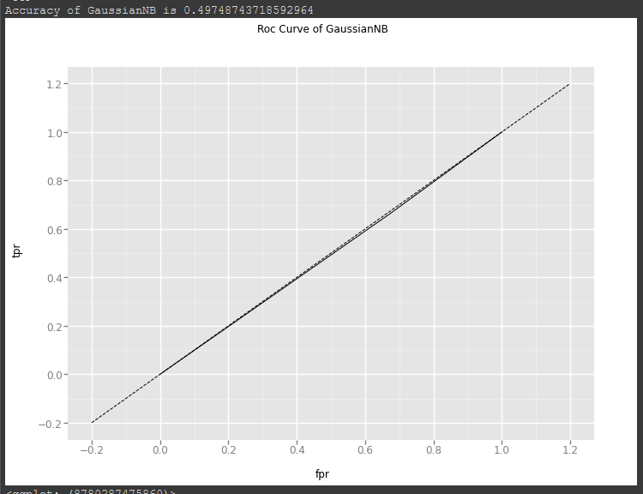
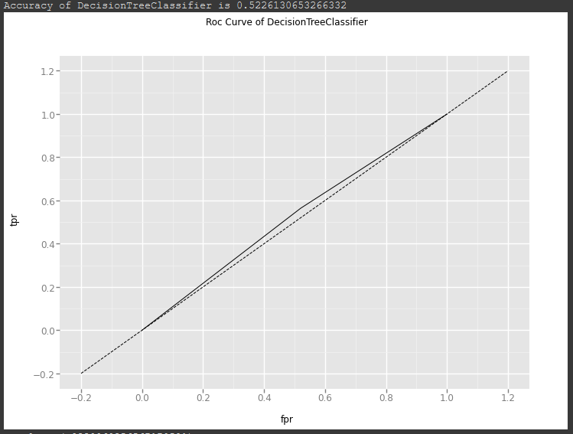
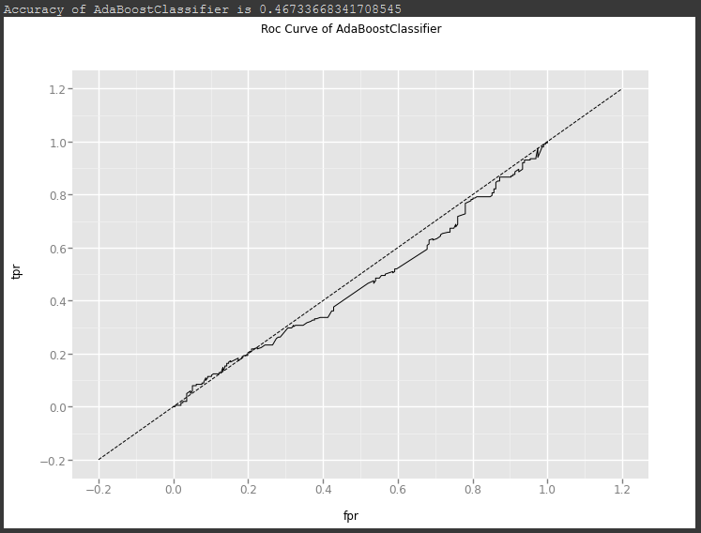
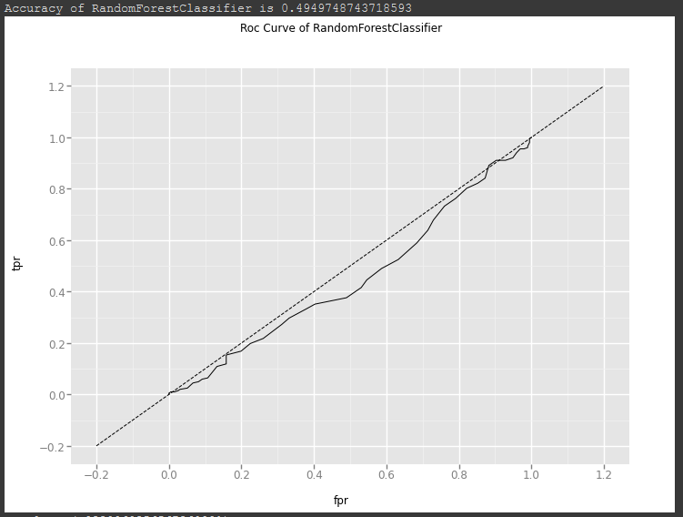
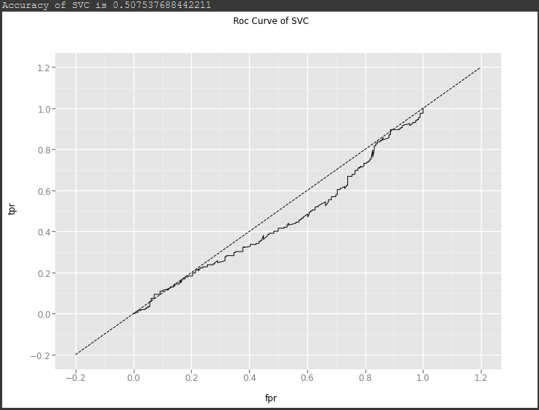
ROC Curves Receiver Operator Characteristics
TPR = Sensitivity
FPR = 1 - Specificity
Naïve Bayes
K-Nearest Neighbor
Logistic Regression
Decision Tree
AdaBoost
Random Forest
Support Vector Classification

Slide 10
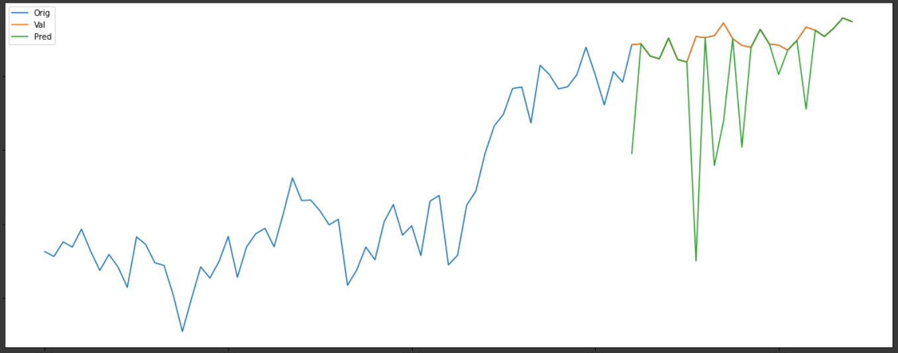
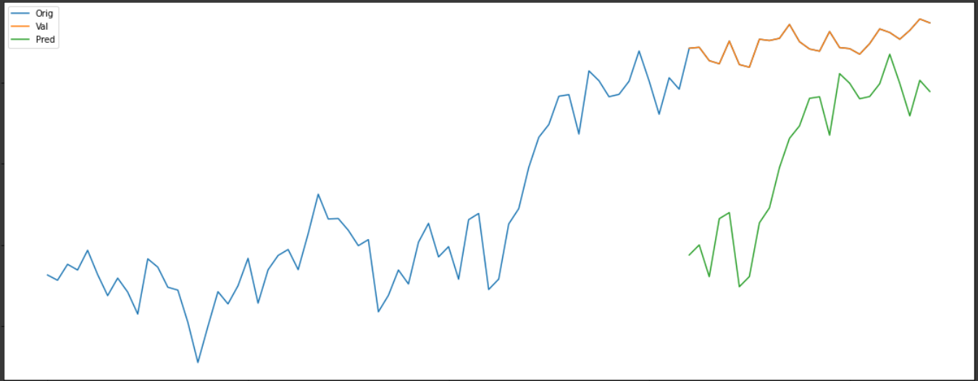
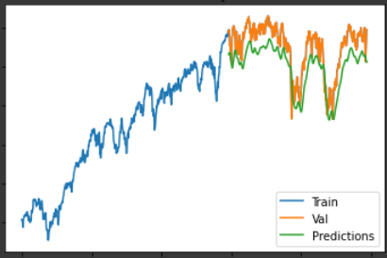
Addendum
Tree prediction
SVR
(Support Vector Regression)
LR prediction
LSTM
(Long Short Term Memory)

Slide 11
Conclusion about NLP Project
Things needs closer inspection before conclusions can be drawn
Are we comparing the correct data against correct data?
(Was Reddit News and DJIA correct datasets to work with in the first place?)
Are there other tools that needs consideration?

Slide 12



Thank you for your attention: Dr. Ceni Babaoglu Dr. Karim El Mokhtari What questions do you have?
The codes and results can be found at Github:
https://github.com/QOneK/Ryerson-Data-Analytics-Final-Project-for-Kyuhwan-Kim

